Slide 1
ME759 High Performance Computing for Applications in Engineering [Spring 2021]
Lecture 06
02/05/2021
Dan Negrut, 2021 ME759 UW-Madison

Slide 2

Cartoon of the day

Slide 3
Is BBC recording on?
If my internet connection goes down, I’ll email from my phone to provide more information – go/no-go, next step, etc.

Slide 4
Before we get started…
Last time
Caches: how they work
Example showing importance of cache locality
Today
Caches, wrap up
Virtual memory
Other tidbits:
Assignment due on Th, 02/11, at 9 pm
Do not run your code on the Euler headnode (use Slurm)
Please read the ME459 “elements of C” material if malloc/new & pointers are not your friends

Slide 5
Opportunity for independent study/research volunteering
If you are interested in computer graphics or computer vision and want to do an independent study or volunteer in a research lab, I’d like to work with you
Interested in working with one or two folks who know C or C++ and can help with simulating autonomous vehicles and robots
A big plus if you are familiar with the Unity3D or Unreal gaming engines, or Carla/LGSVL sim environments
Topics of interest:
Programmatic generation of virtual worlds: off-road scenarios, Mars/Moon, highways.
Sensor simulation (camera simulation, lidar simulation, radar simulation, infrared sensing)
Vehicle autonomy stacks for off-road mobility (like Autoware)
Why help is needed: NASA, US Army, and NSF projects that we want to expand and go beyond the call of duty
For more details, join me before office hours on Monday, February 8
I’ll be in BBC at 7 PM to answer any questions and provide more context
Important: unfortunately, no funding support available. If we work together, it’ll be independent study or research volunteering

Slide 6
The Caching Landscape in the Memory Hierarchy
Cache Type
What is Cached?
Where is it Cached?
Latency (cycles)
Managed By
Registers
4-8 bytes words
CPU core
0
Compiler/CU
TLB
Address translations
On-Chip TLB
0
Hardware MMU
L1 cache
64-byte blocks
On-Chip L1
4
Hardware
L2 cache
64-byte blocks
On-Chip L2
10
Hardware
Virtual Memory
4-KB pages
Main memory
100
Hardware + OS
Buffer cache
Parts of files
Main memory
100
OS
Disk cache
Disk sectors
Disk controller
100,000
Disk firmware
Network buffer cache
Parts of files
Local disk
10,000,000
NFS client
Browser cache
Web pages
Local disk
10,000,000
Web browser
Web cache
Web pages
Remote server disks
1,000,000,000
Web proxy server

Slide 7
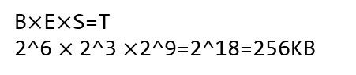
Example [using CAE’s tux-103]
Cache line size: 64 bytes → 2^6 Bytes
8-way associative → 2^3
L2 cache size: 256KB → 2^18 Bytes
Number of sets: 2^18/(2^6*2^3)=2^9=512
B$×$E$×$S=T
2^6 $×$2^3 $×$2^9=2^18=256KB
>> grep . /sys/devices/system/cpu/cpu0/cache/index*/*
/sys/devices/system/cpu/cpu0/cache/index2/coherency_line_size:64
/sys/devices/system/cpu/cpu0/cache/index2/level:2
/sys/devices/system/cpu/cpu0/cache/index2/number_of_sets:512
/sys/devices/system/cpu/cpu0/cache/index2/size:256K
/sys/devices/system/cpu/cpu0/cache/index2/type: Unified
/sys/devices/system/cpu/cpu0/cache/index2/ways_of_associativity:8
>> less /proc/cpuinfo
processor : 0
vendor_id : GenuineIntel
cpu family : 6
model : 60
model name : Intel(R) Core(TM) i5-4570 CPU @ 3.20GHz
stepping : 3
microcode : 0x20
cpu MHz : 3197.500
cache size : 6144 KB
physical id : 0
siblings : 4
core id : 0
cpu cores : 4
apicid : 0
fpu : yes
fpu_exception : yes
cache_alignment : 64
address sizes : 39 bits physical, 48 bits virtual

Slide 8
Revisiting an old slide [hopefully it makes better sense now]
Processor package
Core 0
Core 3
L1 i-cache and d-cache:
32 KB, 8-way,
Access: 4 cycles
L2 unified cache:
256 KB, 8-way,
Access: 10 cycles
L3 unified cache:
8 MB, 16-way,
Access: 20-30 cycles
Block size: 64 bytes for all caches.
Registers
Registers
L1
d-cache
L1
i-cache
L1
d-cache
L1
i-cache
…
L2 unified cache
L2 unified cache
L3 unified cache
(shared by all cores)
Main memory
[Bryant and O‘Hallaron: CMU] →

Slide 9
We’ve done memory reads. What about writes?
Multiple copies of data exist stored in different places and at the same time:
L1, L2, L3, Main Memory, Secondary Memory (Disk)
How should a write-hit be handled?
Write-through (write immediately to main memory as well)
Write-back (defer write to main memory until replacement of line)
Need a dirty bit (indicate whether line different from memory or not)
How should a write-miss be handled?
Write-allocate (load into cache, update line in cache)
Good if more writes to the location follow; i.e., if locality is good
No-write-allocate (writes straight to memory, does not load into cache)
Typical combos met in practice:
Write-back + Write-allocate ← more common
Write-through + No-write-allocate

Slide 10
Cache performance metrics [a nomenclature matter]
Miss Rate
Defined as Miss Rate = 1 – Hit Rate (note that we defined the Hit Rate in the previous lecture)
Represents the fraction of memory references that are not found in cache
Typical numbers (in percentages):
As low as 3-10% for L1
Can be quite small (e.g., < 1%) for L2, depending on size, nature of problem you run, etc.
Hit Time
Time to deliver a line in the cache into a register of the processor
Includes time to determine whether the line is in the cache
Typical numbers:
4 clock cycle for L1
10 clock cycles for L2
Miss Penalty
Additional time required because of a miss
Typically 50-200 cycles for main memory (Trend: slightly increasing)
[Bryant and O‘Hallaron: CMU] →

Slide 11
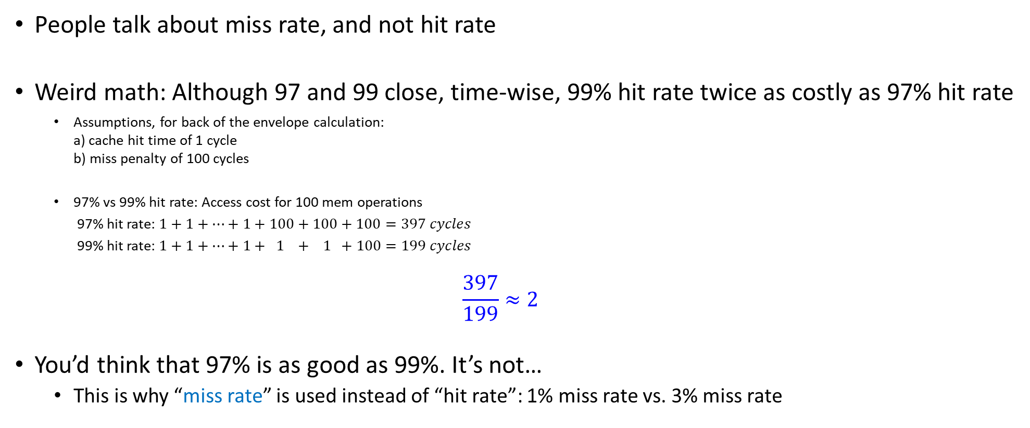
People Talk Miss Rate, Not Hit Rate
People talk about miss rate, and not hit rate
Weird math: Although 97 and 99 close, time-wise, 99% hit rate twice as costly as 97% hit rate
Assumptions, for back of the envelope calculation: a) cache hit time of 1 cycle b) miss penalty of 100 cycles
97% vs 99% hit rate: Access cost for 100 mem operations
97% hit rate: $1+1+…+1+100+100+100=397 cycles$
99% hit rate: $1+1+…+1+ 1 + 1 +100=199 cycles$
$$\frac{397}{199}≈2$$
You’d think that 97% is as good as 99%. It’s not…
This is why “miss rate” is used instead of “hit rate”: 1% miss rate vs. 3% miss rate
[Bryant and O‘Hallaron: CMU] →

Slide 12
Writing Cache Friendly Code: Rules of Thumb (more to come)
Basic facts:
You have no *direct* control over what data gets cached
However, you are not helpless: ensure your code is “local” (spatially and/or temporally)
when you write code, do not violate locality, if at all possible

Slide 13
Other performance rule of thumb
Make the common case go fast
Focus on the inner loops of the “heavy” functions
Try to have cache-friendly code in the inner loops
Repeated references to same variables are good (temporal locality)
“stride of one” reference patterns are good (spatial locality)
[Bryant and O‘Hallaron: CMU] →

Slide 14
Approaching the task of programming
By and large, people write code by paying attention to
Correctness
Esthetics of the solution developed
Objects, lists, patterns, inheritance, etc. – code is flexible and easy to maintain
Portability
Legacy
Data Analytics (Big Data): you should think about performance when writing/designing software
Cache friendly code via “locality” is king
When you write a line of code, always pause and ask yourself: where is this data that I’m referencing here comes from?
Departing thoughts:
Does “performance” come before “esthetics”? Or “portability”?
Good read: “The Mythical Man-Month,” by Frederick Phillips Brooks Jr.

Slide 15
The “Memory Mountain” Experiment
Task at hand in this exercise: adding up numbers in an array (just like example of two lectures ago)
The numbers must be brought over into the chip to be added
Timing how long it takes to finish execution: a good proxy for speed of moving data
Why?
Because the math is trivial, eats up no time at all: sum = sum + a[i]
Moral of the story: the good cases are the ones with very high “effective bandwidth”
“effective bandwidth”: computed by dividing amount of data used during solving problem to the amount of time required to finish the execution
Note: the data used is less than the data moved (you don’t use everything that you move)

Slide 16
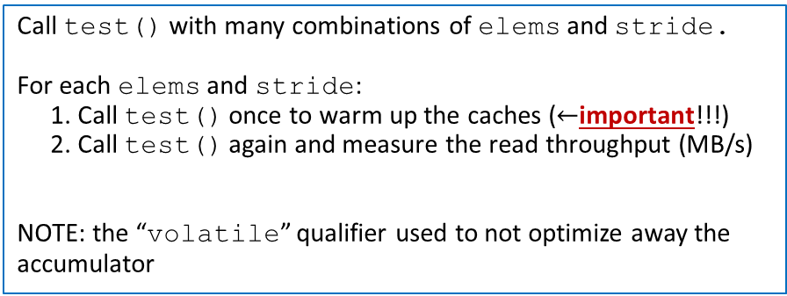
Memory Mountain Test Function
void test(double* data, int elems, int stride) /* The test function */
{
int i;
double result = 0.0;
volatile double sink;
for (i = 0; i < elems; i += stride) {
result += data[i];
}
sink = result; /* So compiler doesn't optimize away the loop */
}
2010 Vintage
Call test() with many combinations of elems and stride.
For each elems and stride:
1. Call test() once to warm up the caches ($←$important!!!)
2. Call test() again and measure the read throughput (MB/s)
NOTE: the “volatile” qualifier used to not optimize away the accumulator
void test(long *data, long elems, long stride)
{
volatile long accum = 0;
long i, sx2 = stride * 2, sx3 = stride * 3, sx4 = stride * 4;
long acc0 = 0, acc1 = 0, acc2 = 0, acc3 = 0;
long length = elems;
long limit = length - sx4;
/* Combine 4 elements at a time */
for (i = 0; i < limit; i += sx4) {
acc0 = acc0 + data[i];
acc1 = acc1 + data[i + stride];
acc2 = acc2 + data[i + sx2];
acc3 = acc3 + data[i + sx3];
}
/* Finish any remaining elements */
for (; i < length; i += stride) {
acc0 = acc0 + data[i];
}
accum = ((acc0 + acc1) + (acc2 + acc3));
}
2016 Vintage
[http://www.cs.cmu.edu/afs/cs/academic/class/15213-f10/www/code/10-cache-memories/mountain/]→
[http://www.cs.cmu.edu/afs/cs/academic/class/15213-f16/www/code/10-cache-memories/mountain/]→

Slide 17
The Memory Mountain [2008]
Core 2 Duo
2.4 GHz
32 KB L1 d-cache
6MB L2 cache
64 B block size
L1
Ridges
of temporal locality
L2
Mem

Slide 18
The Memory Mountain [2014]
Aggressive prefetching
Core i5 Haswell
3.1 GHz
32 KB L1 d-cache
256 KB L2 cache
8 MB L3 cache
64 B block size
L1
Ridges
of temporal locality
L2
L3
Slopes
of spatial locality
Mem
[Bryant and O‘Hallaron: CMU] →

Slide 19
Cache Capacity Effects from Memory Mountain
Main Memory
L3
L2
L1
Core i7 Haswell
3.1 GHz
32 KB L1 Data Cache
256 KB L2 Cache
8 MB L3 Cache
64 B block size
Slice through memory mountain with stride=8
[Bryant and O‘Hallaron: CMU] →

Slide 20
The “Memory Mountain” experiment: closing thoughts
Read throughput (read bandwidth)
Number of bytes read from main memory per second (MB/s)
Memory mountain: Measures read-throughput as a function of spatial and temporal locality
Bandwidth is always the same, but the effective bandwidth changes based on locality
[Bryant and O‘Hallaron: CMU] →

Slide 21
Looking ahead
What we saw in the Memory Mountain experiment:
Sometimes I get a cake, eat a slice and throw away the rest
We’ll touch on this “wasteful use of data” when we talk later about the “roofline model” for performance analysis
We’ll look at the “roofline model” for GPU computing, but it applies to all other flavors of computing: sequential, multi-core, etc.

Slide 22
Rearranging loops to improve spatial locality
Supplemental Reading

Slide 23
Layout of C Arrays in Memory (review)
C arrays allocated in row-major order
Each row in contiguous memory locations
Stepping through columns in one row:
Accesses successive elements
If blockSize B [in bytes] > sizeof(a_{ij}) [in bytes], exploit spatial locality
Miss Rate = sizeof(a_{ij}) / B
Stepping through rows in one column:
Accesses distant elements
When N is large, no spatial locality
Miss rate = 1 (i.e. 100%)
for (i = 0; i < N; i++)
sum += a[0][i];
for (i = 0; i < N; i++)
sum += a[i][0];
[Bryant and O‘Hallaron: CMU] →

Slide 24
Matrix Multiplication Example
Description:
Multiply two N x N matrices
Matrix elements are doubles (8 bytes)
2N³ total FP operations
N reads per matrix entry
N values summed to get one entry
But may be able to hold in register
Variable sum
held in register
/* ijk */
for (i=0; i<n; i++) {
for (j=0; j<n; j++) {
sum = 0.0;
for (k=0; k<n; k++)
sum += a[i][k] * b[k][j];
c[i][j] = sum;
}
}
matmult/mm.c
[http://www.cs.cmu.edu/afs/cs/academic/class/15213-f16/www/code/12-cache-memories/matmult]→

Slide 25
Miss Rate Analysis for Matrix Multiply
Assume:
Block size = 64B (big enough for four doubles)
Matrix dimension (N) is very large
Approximate 1/N as 0.0
Cache is not even big enough to hold multiple rows
Analysis Method:
Look at access pattern of inner loop
j
k
j
=
x
i
i
k
C
A
B
[Bryant and O‘Hallaron: CMU] →

Slide 26
Matrix Multiplication (ijk)
/* ijk */
for (i=0; i<n; i++) {
for (j=0; j<n; j++) {
sum = 0.0;
for (k=0; k<n; k++)
sum += a[i][k] * b[k][j];
c[i][j] = sum;
}
}
Inner loop:
(*,j)
(i,j)
(i,*)
A
B
C
matmult/mm.c
Row-wise
Column-
wise
Fixed
Misses per inner loop iteration:
A B C
0.125 1.0 0.0
[Bryant and O‘Hallaron: CMU] →

Slide 27
Matrix Multiplication (jik)
/* jik */
for (j=0; j<n; j++) {
for (i=0; i<n; i++) {
sum = 0.0;
for (k=0; k<n; k++)
sum += a[i][k] * b[k][j];
c[i][j] = sum
}
}
Inner loop:
(*,j)
(i,j)
(i,*)
A
B
C
matmult/mm.c
Row-wise
Column-
wise
Fixed
Misses per inner loop iteration:
A B C
0.125 1.0 0.0
[Bryant and O‘Hallaron: CMU] →

Slide 28
Matrix Multiplication (kij)
/* kij */
for (k=0; k<n; k++) {
for (i=0; i<n; i++) {
r = a[i][k];
for (j=0; j<n; j++)
c[i][j] += r * b[k][j];
}
}
Inner loop:
(i,k)
(k,*)
(i,*)
A
B
C
matmult/mm.c
Fixed
Row-wise
Row-wise
Misses per inner loop iteration:
A B C
0.0 0.125 0.125
[Bryant and O‘Hallaron: CMU] →

Slide 29
Matrix Multiplication (ikj)
/* ikj */
for (i=0; i<n; i++) {
for (k=0; k<n; k++) {
r = a[i][k];
for (j=0; j<n; j++)
c[i][j] += r * b[k][j];
}
}
Inner loop:
(i,k)
(k,*)
(i,*)
A
B
C
matmult/mm.c
Fixed
Row-wise
Row-wise
Misses per inner loop iteration:
A B C
0.0 0.125 0.125
[Bryant and O‘Hallaron: CMU] →

Slide 30
Matrix Multiplication (jki)
Inner loop:
/* jki */
for (j=0; j<n; j++) {
for (k=0; k<n; k++) {
r = b[k][j];
for (i=0; i<n; i++)
c[i][j] += a[i][k] * r;
}
}
(*,k)
(*,j)
(k,j)
A
B
C
matmult/mm.c
Column-
wise
Fixed
Column-
wise
Misses per inner loop iteration:
A B C
1.0 0.0 1.0
[Bryant and O‘Hallaron: CMU] →

Slide 31
Matrix Multiplication (kji)
/* kji */
for (k=0; k<n; k++) {
for (j=0; j<n; j++) {
r = b[k][j];
for (i=0; i<n; i++)
c[i][j] += a[i][k] * r;
}
}
Inner loop:
(*,k)
(*,j)
(k,j)
A
B
C
matmult/mm.c
Column-
wise
Fixed
Column-
wise
Misses per inner loop iteration:
A B C
1.0 0.0 1.0
[Bryant and O‘Hallaron: CMU] →

Slide 32
Summary of Matrix Multiplication
for (i=0; i<n; i++) {
for (j=0; j<n; j++) {
sum = 0.0;
for (k=0; k<n; k++)
sum += a[i][k] * b[k][j];
c[i][j] = sum;
}
}
ijk (& jik):
2 loads, 0 stores
misses/iter = 1.125
for (k=0; k<n; k++) {
for (i=0; i<n; i++) {
r = a[i][k];
for (j=0; j<n; j++)
c[i][j] += r * b[k][j];
}
}
kij (& ikj):
2 loads, 1 store
misses/iter = 0.25
for (j=0; j<n; j++) {
for (k=0; k<n; k++) {
r = b[k][j];
for (i=0; i<n; i++)
c[i][j] += a[i][k] * r;
}
}
jki (& kji):
2 loads, 1 store
misses/iter = 2.0
[Bryant and O‘Hallaron: CMU] →

Slide 33
2008-era Matrix Multiply Performance
Nanoseconds per floating-point operation. Measured on 2.4GHz Core 2 Duo
jki / kji (2.0)
ijk / jik (1.125)
kij / ikj (0.25)
[Bryant and O‘Hallaron: CMU] →

Slide 34
2014-era Matrix Multiply Performance
Nanoseconds per floating-point operation. Measured on 3.1 Ghz Haswell
jki / kji (2.0)
ijk / jik (1.125)
kij / ikj (0.25)
[Bryant and O‘Hallaron: CMU] →

Slide 35
New Topic: Virtual Memory

Slide 36
Why talk about “Virtual Memory”?
Understand how memory transactions take place, and why some incur higher overhead
Add more credibility to some key points of this course, e.g.,
Number crunching is inexpensive
Moving information back and forth is expensive
Both in terms of time & power

Slide 37
Why talk about “Virtual Memory”?
It will help us understand how unlucky a memory transaction can become
E.g.: page faults, memory thrashing :-(
It’ll make us appreciate caches even more
They serve multiple purposes, e.g., help with: data storage, instruction storage, finding things in main memory (address translation)
It helps us understand how unified memory works for GPU computing (discussed later, after GPU computing segment)
Notes:
DN: nice summary of page faults vs thrashing is here - https://stackoverflow.com/questions/19031902/what-is-thrashing-why-does-it-occur

Slide 38
Motivating Questions/Issues [1/3]
Question 1: How come you might have only 512MB of main memory on your laptop, yet you can new[] an array of 1 GB?
Notes:
Also, how can two processes that know nothing about each other refer to and use seemingly the exact same memory location (say 0x001a3df2)?
Moreover, what (where) is memory location 0x001a3df2?

Slide 39
Motivating Questions/Issues [2/3]
Question 2: How can 20+ processes seemingly run at the same time? How do they each know where they can read/write data from/to?
Assume I have 1 GB of RAM, and programA allocates 2 GB of memory and programB allocates 2 GB of memory. How can they run at the same time?
Does programA need to know what addresses in memory it can use for data so that it doesn’t step on the feet of programB (and perhaps programC, programD, etc.)?
Notes:
Also, how can two processes that know nothing about each other refer to and use seemingly the exact same memory location (say 0x001a3df2)?
Moreover, what (where) is memory location 0x001a3df2?

Slide 40
Motivating Questions/Issues [3/3]
Question 3: How can you compile a program on a Windows workstation with 16 GB of memory and run it later on a different laptop with 1 GB of memory; i.e., less memory?
Are there any problems w/ addresses being referenced by the instructions?
Notes:
Also, how can two processes that know nothing about each other refer to and use seemingly the exact same memory location (say 0x001a3df2)?
Moreover, what (where) is memory location 0x001a3df2?

Slide 41
Preamble, Virtual Memory
When you compile a program there is no way to know where in the physical memory the code will get its data allocated
There are other “tenants” that inhabit the physical memory & they are already there before you get there
Solution: the code compiled under assumption that resulting process has undisputed access to 4 GB of pristine memory (on 32 bit systems)
The “pristine memory” is called the virtual memory space
Notes:
hardware (MMU: memory management unit) converts virtual addresses into physical addresses
OS provides support for paging (conceptually using more memory than physically available)

Slide 42
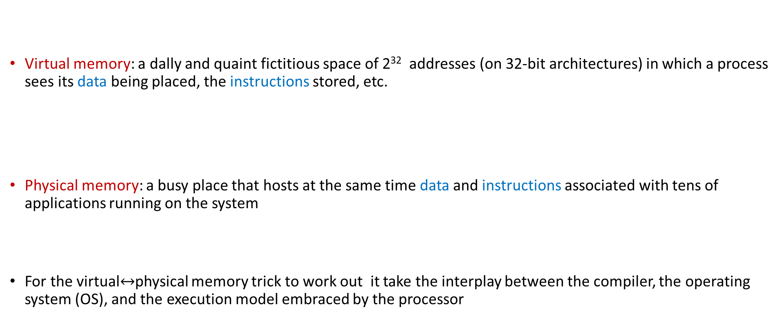
Virtual vs. Physical Memory
Virtual memory: a dally and quaint fictitious space of 2³² addresses (on 32-bit architectures) in which a process sees its data being placed, the instructions stored, etc.
Physical memory: a busy place that hosts at the same time data and instructions associated with tens of applications running on the system
For the virtual$↔$physical memory trick to work out it take the interplay between the compiler, the operating system (OS), and the execution model embraced by the processor

Slide 43
Why do we like Virtual Memory?
The Virtual Memory paradigm allows:
Running programs that require more memory than physically available
Running multiple programs “simultaneously” (multi-tasking)
Handling of memory fragmentation/segmentation insofar as the main memory is concerned
Transparent and unitary handling of memory and secondary storage (hard disk / solid state disk)
What is the hardware component that manages the Virtual Memory show?
The Memory Management Unit (MMU)
MMU part of the chip these days (back in the day, it used to be an entity by itself, off chip)

Slide 44
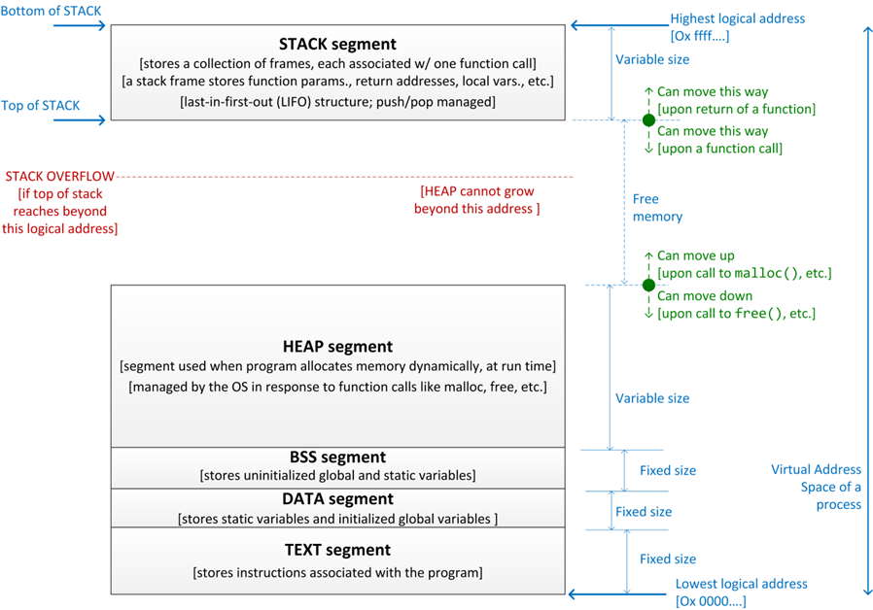

The Virtual Memory: its structure, and how it changes during execution [How perceived by compiler & runtime]
$2^{32}$ addresses (32 bit OS)
Notes:
Ignore for the moment the messiness of the physical memory and concentrate on how the “pristine” layout of the virtual memory is seen by a process.
Each process partitions its virtual memory layout in several segments as shown here.

Slide 45
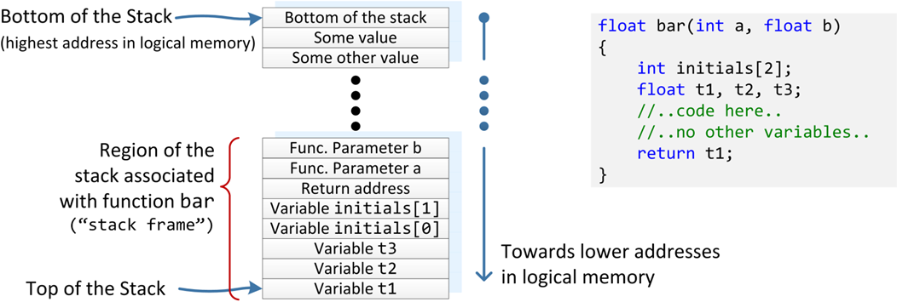
Anatomy of the Stack
Function bar and associated stack frame
Should the function bar be called, this is how the stack should be pushed
A “pop” operation is the opposite, it shrinks the stack
This is where the top of the stack used to be before function bar was called
Notes:
Reasons for the stack: you don’t know how many times a function is called. The function needs to place its data somewhere, right? It’s like a hidden malloc followed by a copying the arguments (a and b, above) in this memory, which will also be hit by t1, t2, etc.
The stack is a segment of fixed size that is managed in a LIFO manner (push and pop).
Order of variables in stack is decided by compiler. Typically arrays are stored contiguously.
Note: stack also stores value of return address (from subroutine). This is a back-door that can be used by malicious programs to hijack execution: bar() above could try to write to initials[1000] in the hope to overwrite a return address for a function higher up in the call stack.

Slide 46
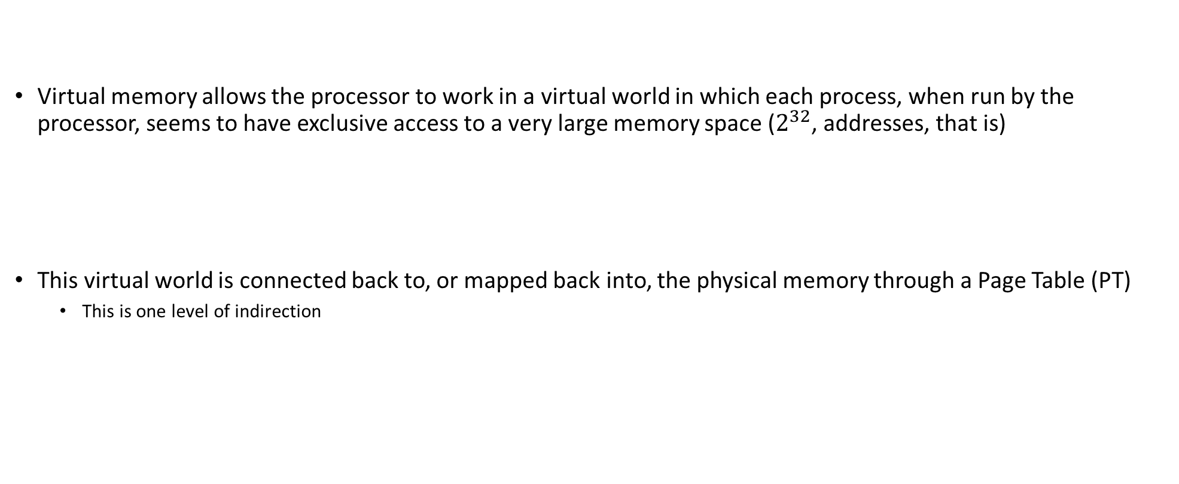
Virtual Memory: The Page Table
Virtual memory allows the processor to work in a virtual world in which each process, when run by the processor, seems to have exclusive access to a very large memory space ($2^{32}$, addresses, that is)
This virtual world is connected back to, or mapped back into, the physical memory through a Page Table (PT)
This is one level of indirection
Notes:
Back to the MMU’s job: Translating between virtual addresses and physical addresses. This is done through a so-called Page Table
To see how the PT works, let’s first dissect a virtual memory address…

Slide 47
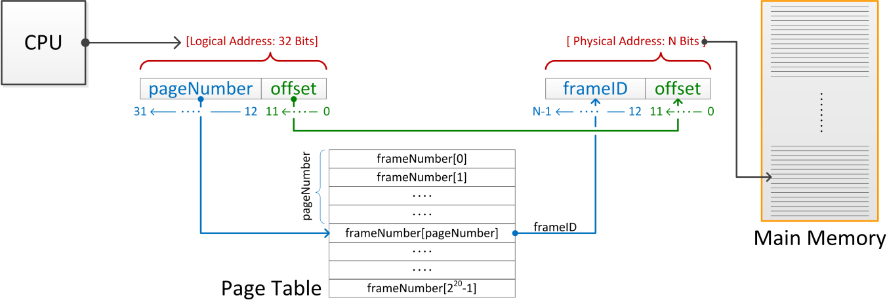
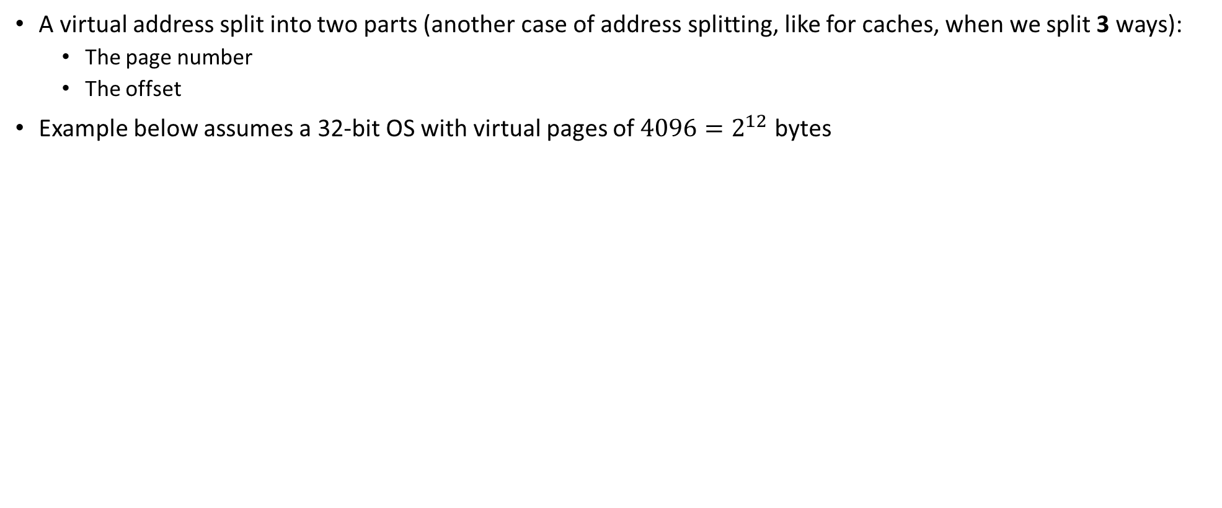
Anatomy of a Virtual Memory Address
A virtual address split into two parts (another case of address splitting, like for caches, when we split 3 ways):
The page number
The offset
Example below assumes a 32-bit OS with virtual pages of $4096=2^{12}$ bytes
[physical memory]
Notes:
The virtual memory is split into pages.
The physical memory is split into frames.
This is for a 32-bit OS with virtual pages of 4096 bytes.
4096 = 2^12 → need 12 bits to indicate the offset in the page.
(Note: unit of address resolution is 8 bits → a virtual page holds 4 KB)
The remaining 32-12 = 20 bits used to index into the Page Table to get the corresponding frame number (which is held in N bits)

Slide 48
Anatomy of a Virtual Memory Address
A page of virtual memory corresponds to a frame of physical memory
The size of a page (or frame, for that matter) is typically 4096 bytes
Compare to 64 bytes, the size of a memory block (cache line)
2¹²=4096: 12 bits of the address are sufficient to relatively position each byte in a page
Bits marked 0 through 11 on the previous slide

Slide 49
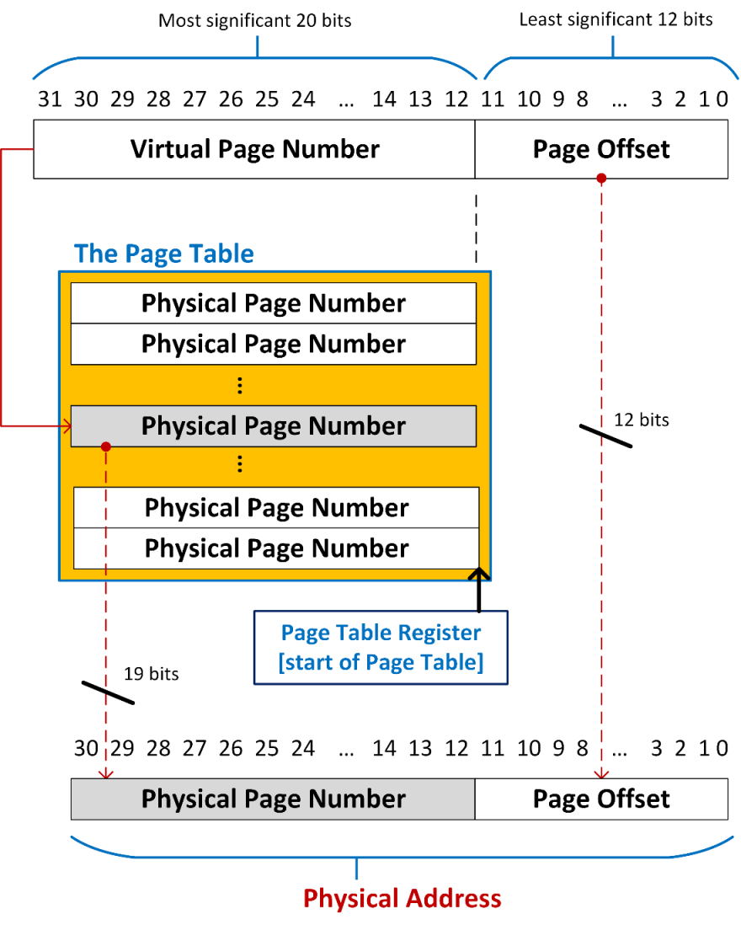
The Translation Process
Example: imagine that your physical memory is 2 GB
The physical address has 31 bits: 2³¹=2GB
Then the page table converts the bits 12 through 31 of the virtual address into bits 12 through 30 of the physical address
Notes:
N depends on the amount of available RAM:
e.g. for 2GB of RAM, N=19. Because 2GB=2^31 bits and 31=12+19
since N max = 20 → a 32-bit OS can reference 4GB of memory → a maximum of 1 million pages
each address requires 4bytes → the PT takes 4MB
each active application has its own PT → lots of memory just for the PTs

Slide 50
Comments on the Page Table (PT): Preamble to TLB
Page table enables the translation of virtual addresses into physical addresses
Every single process executing on a processor and managed by the OS has its own page table
Page table is stored in main memory
For a 32-bit operating system size of a page table can be up to 4 MB in size
4 MB: 2^20 addresses, each requiring 4(?) bytes to encode
Start address of the PT for a process is stored in a dedicated register (PTR)
The job of the Operating System to take care of this
Notes:
Recall:
N depends on the amount of available RAM:
e.g. for 2GB of RAM, N=19. Because 2GB=2^31 bits and 31=12+19
since N max = 20 → a 32-bit OS can reference 4GB of memory → a maximum of 1 million pages
each address requires 4bytes → the PT takes 4MB
each active application has its own PT → lots of memory just for the PTs
NOTE: memory requirements for PT even slightly larger than that: there are additional bits associated with each entry, e.g.
valid bit indicating if the physical address is on secondary storage
use bit used in LRU eviction strategy

Slide 51
The TLB [Translation Lookaside Buffer] [1/2]
If you go to Page Table in main memory for each address translation this would be very costly
One trip to translate address, one trip to actually fetch the data
There is a “cache” for the address translation process: TLB
Translation Lookaside Buffer: holds the translation of a small collection of virtual page numbers into frame IDs
Notes:
On page fault, the OS does the following:
data requested is located in secondary storage
request made for an entire (“surrounding”) frame to be brought over in main memory
room is made for the new frame as a virtual page (this may require evicting an existing one; e.g. using a LRU strategy)
the new frame is loaded in the virtual page
the PT is updated to reflect the change
control returns to process which is instructed to retry the instruction that led to a page fault

Slide 52
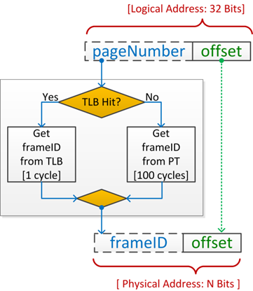
Illustration: The role of the TLB
A TLB is just another cache
Implemented in hardware, on-chip
A TLB miss leads to substantial overhead in the translation of a virtual memory address
Notes:
Without a TLB, the purpose of caches would be defeated: a trip to memory would be required just to interrogate the PT to figure out the actual physical address of the required information (instruction or data)
Typically, TLB has between 16 and 512 entries.
Its “cache line” is 2 PT rows.
Mapping is usually fully associative.
Hit time very short (1 cycle)
Miss penalty 10-100 cycles
Typical TLB miss rate: 0.01 – 0.1%

Slide 53
The TLB [Translation Lookaside Buffer] [2/2]
The Good, the Bad and the Ugly [1966, Rated R, w/ Clint Eastwood, 97% Rotten Tomatoes]
The Good: the TLB leads to a hit and allows for quick address translation
The Bad: TLB doesn’t have the required information cached and a trip to main memory in order
The Ugly: the value at address that was just translated is not in cache and trip to main memory in order
The Really Ugly: the requested frame not in main memory and a trip to secondary memory in order
Called “page fault,” you’re hitting significant latency at this point
“memory thrashing”: repeatedly hitting page fault upon page fault, to the point where time wasted in handling page faults dominates all the rest
Purpose of this slide: understand what happens when you don’t hit caches and you need to figure out where your data is and then fetch it
Notes:
On page fault, the OS does the following:
data requested is located in secondary storage
request made for an entire (“surrounding”) frame to be brought over in main memory
room is made for the new frame as a virtual page (this may require evicting an existing one; e.g. using a LRU strategy)
the new frame is loaded in the virtual page
the PT is updated to reflect the change
control returns to process which is instructed to retry the instruction that led to a page fault

Slide 54
Quick side-trip, speed of memory
We saw 5X to 30X speedup if we hit the cache (good locality)
Scenario: cache miss, you go to main memory
When handling large data sets, if they don’t fit in main memory and spill into secondary memory, lack of locality can lead to 1000X slowdowns
Scenario: main memory page fault (even worse if you start getting into memory thrashing)

Slide 55
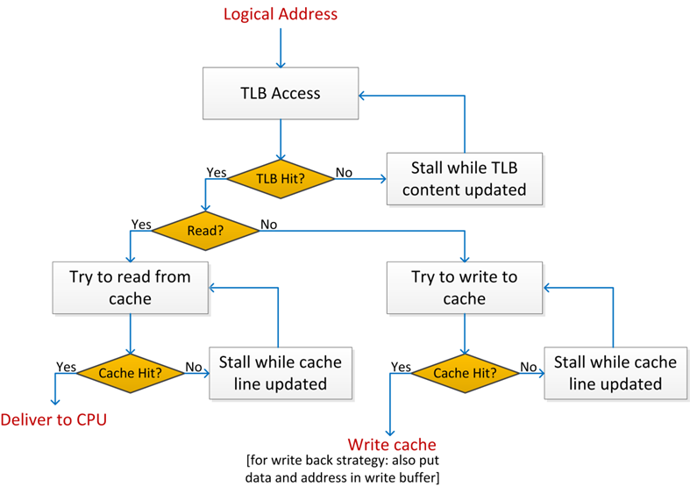
Memory Access: The Big Picture, Includes Cache
A simplified version of how a memory request is serviced:
Notes:
Note that the virtual memory mechanism allows looking at main memory as a “cache” for secondary storage.
Memory block → memory frame
Cache line (64 bytes) → virtual memory page (4096 bytes)
Cache miss → page fault
Note: page fault much more costly (secondary storage is even “farther” from RAM than RAM is to CPU)

Slide 56
Quiz: on the likelihood of a “miss”
Say an integer operand from some address is needed to do some computation in the ALU.
When is it more likely to not hit the cache?
When you are looking for the operand in the data cache
When you are doing the page translation associated with the address of the integer
Notes:
Looking for operand: you’re dealing w/ a cache line. For integers, there are 15 more integers next to you, in the same cache line
Looking for a page translation: there are 4096 bytes that share the same page, so there are 1023 other integers that will hit the same Page Table entry

Slide 57
Quiz: Chop time for Cache read$→$ Virtual or Physical address?
To do, for instance, a cache read, you chop the address in three parts
Based on the picture at the right, what gets chopped in three parts: an address in virtual memory or in physical memory?

Slide 58
Memory-related aspects: various other tidbits
Going on several tangents
Virtual vs. Physical memories: how their size comes into play
Pointers in gdb/Visual Studio: pointing into virtual or physical memory?
Unit of address resolution
Difference between thread and process (came up in the context of TLP)
32 to 64 bit transition
Frame size

Slide 59
Virtual vs. Physical memories: how their size comes into play
Assumption: in this discussion we’re dealing with a 32 bit operating system
Simpler to talk about it, fewer bits/smaller memories to keep track of. Nothing changes for 64 bit OSs
Case 1: The physical memory smaller than virtual memory
Case 2: The physical memory larger than virtual memory

Slide 60
Case 1: Assume 2GB MB of RAM (my slim laptop)
2 GB of RAM: 2X more addresses in virtual memory than you have in physical memory
Depending how much memory your program uses, multiple virtual pages are going to be mapped into the same physical frame
Consequence: in reality, each entry in the Page Table always has [at least] one additional bit
clean/dirty bit – indicates that translation to frame should not proceed immediately

Slide 61
The Clean/Dirty Bit & the concept of Page Fault
Bit is “clean”: two conditions need to happen for the bit to be clean
The frame that the page gets translated into has been loaded in main memory (think onset of execution)
Since last translation, that very frame has not been associated with other virtual page
Bit is “dirty”:
We called this before “page fault”, costly scenario to handle
The OS will look for the needed frame on disk (secondary memory)
The way you can think about it: the RAM (main mem) is the cache of the hard-disk (secondary mem)
If bit in Page Table is dirty, the translation refers to address in secondary memory, not in main memory

Slide 62
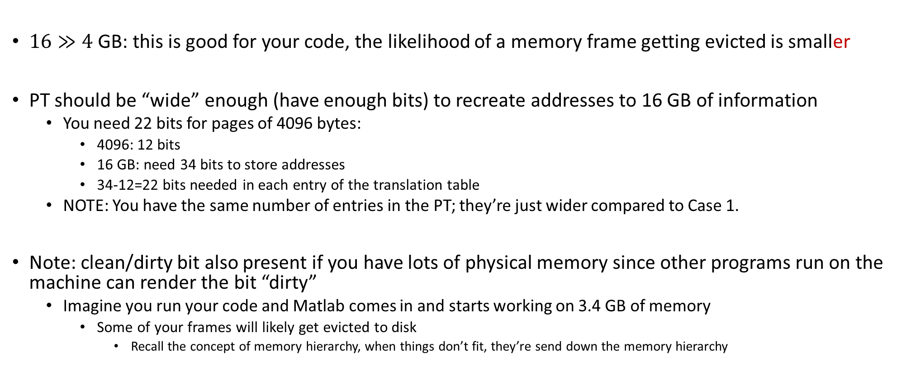
Case 2: Assume 16 GB of RAM (beefy workstation)
$16≫4$ GB: this is good for your code, the likelihood of a memory frame getting evicted is smaller
PT should be “wide” enough (have enough bits) to recreate addresses to 16 GB of information
You need 22 bits for pages of 4096 bytes:
4096: 12 bits
16 GB: need 34 bits to store addresses
34-12=22 bits needed in each entry of the translation table
NOTE: You have the same number of entries in the PT; they’re just wider compared to Case 1.
Note: clean/dirty bit also present if you have lots of physical memory since other programs run on the machine can render the bit “dirty”
Imagine you run your code and Matlab comes in and starts working on 3.4 GB of memory
Some of your frames will likely get evicted to disk
Recall the concept of memory hierarchy, when things don’t fit, they’re send down the memory hierarchy

Slide 63
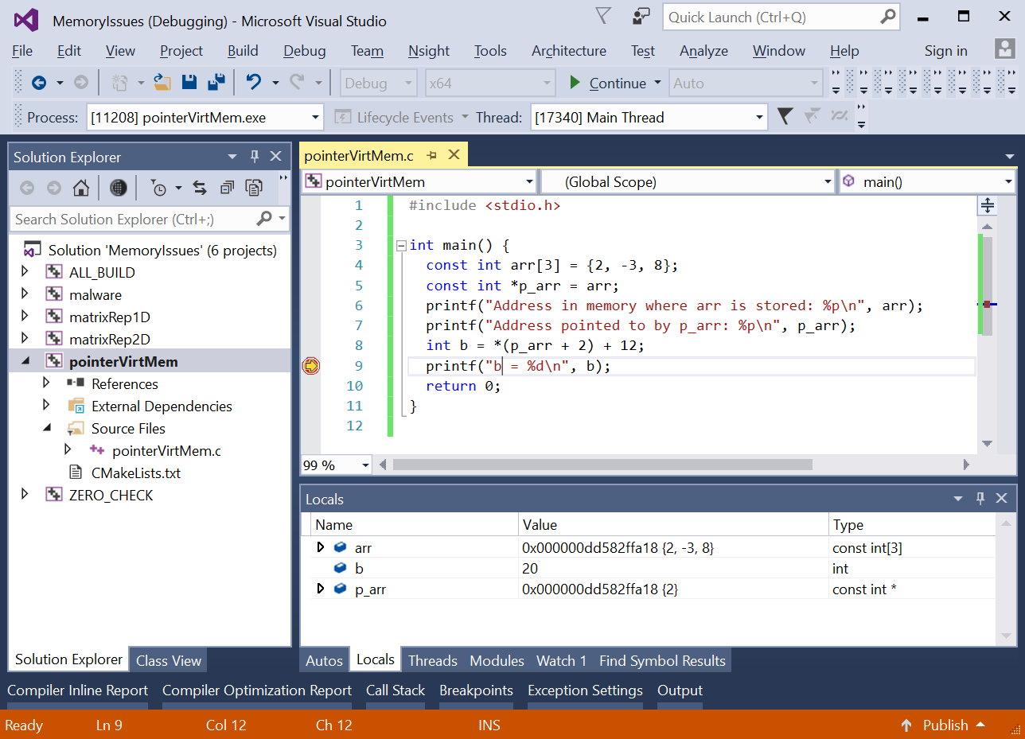
[Short Topic] gdb/VS Pointers: Pointing In Virtual or Physical Memory?
Q: Is 0x000000DD582FFA18 an address in the virtual mem. or in the physical mem.?
A: This is a virtual memory address
You see physical addresses if you are Linus Torvalds and work on kernel development
Quick note: addresses are provided in hex representation
Fewer digits to look at (would you prefer to look at 64 binary digits?)
Easy to figure out – each byte filled w/ binary digits translates into two digits out of the 16 hex digits used for the address
[https://inst.eecs.berkeley.edu/~cs61c/sp14/disc/12/dis12Sol.pdf]$→$

Slide 64
[Short Topic] The Unit of Address Resolution
How many bits are available for data storage at each address?
Example:
We have 2³² addresses that we can access
If each address points to a location that stores 8 bits (one byte) then we have 4 GB of addressable memory
However, if each address refers to a location that stores 2 bytes, we have 8 GB of addressable memory
Intel and AMD CPUs: the unit of address resolution is 1 byte (8 bits)
Consequence: the Intel 32 bit processors “see” a virtual memory space that can be 4 GB big and can reference each byte therein

Slide 65
[New Short Topic] Difference between thread and process
A processor (core) can execute instructions from multiple threads at the same time
This is a facet of TLP
Example: OpenMP launches 2 threads to perform a for-loop in parallel
A processor (core) can execute instructions from multiple processes at the same time
This is a facet of TLP
Example: the OS runs both Outlook client and Chrome, and they’re simultaneously executed
What is the difference?
The threads operate in the same virtual memory space; therefore, there is one Page Table
The processes each has its own virtual memory space; therefore, there are two Page Tables

Slide 66
In the weeds… A matter of semantics
The OS runs your program
The program is run
The processor (core) executes [the instructions of] your program
The instructions are executed

Slide 67
[New Short Topic] The 32 to 64 bit migration (1/2)
If the architecture and OS have 32 bits to represent addresses, it means that 2³² addresses can be referenced
The data sets that we’re working with today are really large
Having only 2³² addresses to work with hardly enough
Example: I have 32 GB of RAM and need to work with 8 GB array. How do I reach the end of array? Addresses are not large enough…
This motivated push towards having addresses represented using 64 bits:
Memory space that I can address balloons to 2⁶⁴ bytes

Slide 68
The 32 to 64 Bit Migration (2/2)
Note that a 64 bit architecture typically calls for two things:
From a hardware perspective: size of the registers, translation tables, tags in caches, etc. – they need to change
From a software/OS perspective, the program “operates” in a huge virtual memory space
The new number of addressable bytes: 18,446,744,073,709,551,615
In reality, the virtual memory addresses are represented using only about 40 to 50 bits
Notes:
But, a shift from 32-bit to 64-bit isn’t an automatic win
“Your pointers will get bigger; your alignment boundaries get bigger; your data is less dense; equivalent code is bigger. You will fit less useful information into one cache line, code and data, and you will therefore take more cache misses. Everything, but everything, will suffer. Your processor's cache did not get bigger. Even other programs on your system that have nothing to do with the code you’re running will suffer. And you didn’t need the extra memory anyway. So you got nothing. Yay for speed-brakes.”
Rico Mariani (Microsoft) on why Visual Studio is still a 32-bit application

Slide 69
Example [using CAE’s tux-103]
>> less /proc/cpuinfo
processor : 0
vendor_id : GenuineIntel
cpu family : 6
model : 60
model name : Intel(R) Core(TM) i5-4570 CPU @ 3.20GHz
stepping : 3
microcode : 0x20
cpu MHz : 3197.500
cache size : 6144 KB
physical id : 0
siblings : 4
core id : 0
cpu cores : 4
apicid : 0
fpu : yes
fpu_exception : yes
cache_alignment : 64
address sizes : 39 bits physical, 48 bits virtual

Slide 70
[New Short Topic] The size of the frame/page
Refresher: a memory page, or virtual page, is a fixed-length contiguous block of virtual memory, described by a single entry in the Page Table
The frame is the fysical (or physical) counterpart of a virtual page
Typically, size of page is 4 KB but can be of 1024 KB for certain applications
Example: working with very large data sets (big data)

Slide 71
The size of the frame/page
Large page size, pros
Less TLB pressure
Why?
Fewer pages to blanket the virtual memory means fewer entries in the Page Table, which means
Fewer values that compete for storage in the TLB cache. More TLB hits: faster program
[not that big of a deal] The size of the Page Table is smaller – less memory needed to store it
Large page size, cons
Might lead to wasteful use of physical memory
Example: page size 1024 KB. If you need to allocate 1030 KB of memory, you use two pages/frames
If your process doesn’t use rest of the second page, then there’ll be a sizeable hole in physical memory

Slide 72
The size of page/frame
Architecture | Smallest page size | Larger page sizes
x86-64 | 4 KiB | 2 MiB, 1 GiB
UltraSPARC Architecture 2007 | 8 KiB | 64 KiB, 512 KiB, 4 MiB, 32 MiB, 256 MiB, 2 GiB, 16 GiB
SPARC v8 with SPARC Reference MMU | 4 KiB | 256 KiB, 16 MiB
Power Architecture | 4 KiB | 64 KiB, 16 MiB, 16 GiB
IA-64 (Itanium) | 4 KiB | 8 KiB, 64 KiB, 256 KiB, 1 MiB, 4 MiB, 16 MiB, 256 MiB
ARMv7 | 4 KiB | 64 KiB, 1 MiB, 16 MiB
32-bit x86 | 4 KiB | 2 MiB, 4 MiB
[https://en.wikipedia.org/wiki/Page_(computer_memory)]$→$

Slide 73
Departing thoughts, memory aspects
Memory transactions:
Add overhead, at times rather large, owing to complex process of moving data
From disk to main memory to cache to register
Time and power costly
Keep in mind the memory hierarchy; understand the size of the memories on your machine
The closer to the top of the hierarchy, the better off you are
If the speed of the code matters, pay attention to how you use memory

Slide 74
Side-trip: Using C/C++ in this class
Using C/C++ in this class: good vehicle to explain how memory works
Two aspects that bring C++ close to hardware: pointers & the new (memory allocation) operator
The overhead of memory transactions is there in any language (Fortran, Matlab, Python, etc.)
For your favorite language, learn how indexing into your arrays doesn’t violate locality

Slide 75
Parallel computing: why, and why now?

Slide 76
Acknowledgements
Sources for some of the material presented today
Hennessy and Patterson (Computer Architecture, 5th edition)
John Owens, UC-Davis
Darío Suárez, Universidad de Zaragoza
John Cavazos, University of Delaware
Others, as indicated on various slides
I apologize if I included a slide and didn’t give credit where was due
Any mistakes in these slides belong to me, not the individuals above

Slide 77
Argument made in this segment of the course
Sequential computing execution speed: only modest gains over the last decade
Parallel computing is where speed improvements have come from

Slide 78
Main causes for sequential computing speed stalling
Memory Wall
Instruction Level Parallelism (ILP) Wall
Power Wall
Not necessarily walls, but increasingly steep hills to climb
Source: “The Many-Core Inflection Point for Mass Market Computer Systems”, by John L. Manferdelli, Microsoft Corporation
Notes:
Predicted in 2000:

Slide 79
Memory Wall
Memory Wall: What is it?
The growing disparity of speed between CPU and memory outside the chip
Memory accesses have gradually become a mighty barrier to computer performance improvements
The trend: ever growing caches to improve average memory reference time to fetch or write instructions or data
Caches are a transistor black hole
Also, as cache gets gradually larger, it also gets gradually slower
Memory Wall: due to latency and limited communication bandwidth beyond chip boundaries.

Slide 80
Memory Latencies [typical server and mobile computers]
Server
CPU
Registers
Mobile
Courtesy of Elsevier, Computer Architecture, Hennessey and Patterson, fifth edition
Notes:
Hammad: in the fifth edition of the book embedded/mobile have their own diagram

Slide 81
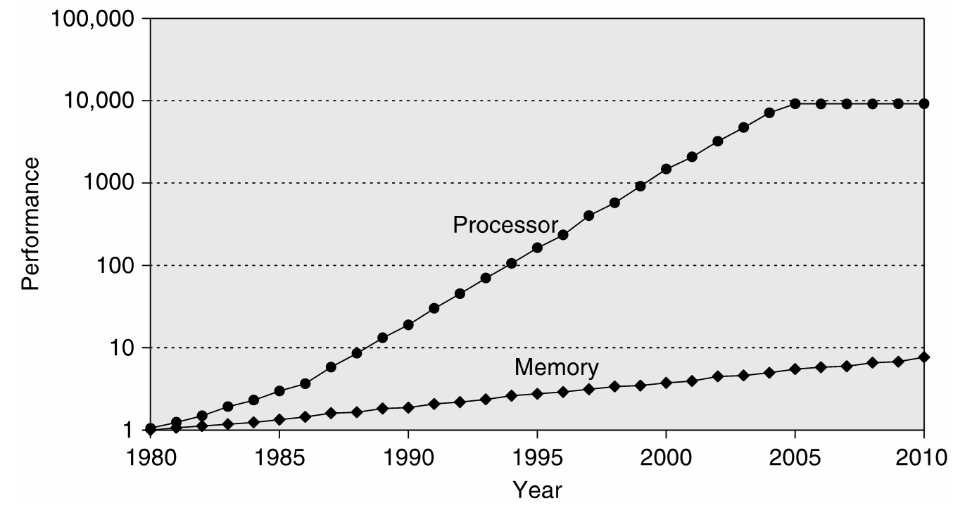
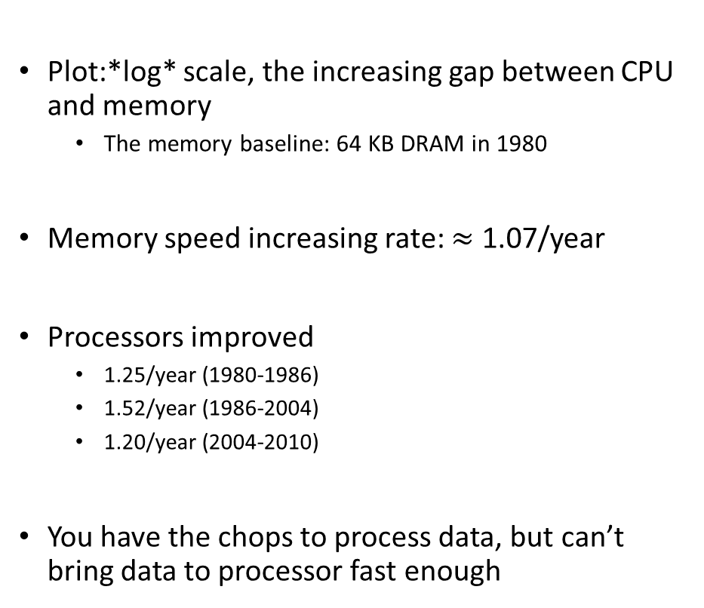
Memory Speed: Widening of the Processor-DRAM Performance Gap
Plot:*log* scale, the increasing gap between CPU and memory
The memory baseline: 64 KB DRAM in 1980
Memory speed increasing rate: $≈$ 1.07/year
Processors improved
1.25/year (1980-1986)
1.52/year (1986-2004)
1.20/year (2004-2010)
You have the chops to process data, but can’t bring data to processor fast enough

Slide 82
Memory Latency vs. Memory Bandwidth
Latency [in our context]: how much time it takes a packet of data to get from one designated point to another
Measured in seconds, also called “lag”
The utility “ping” in Linux measures the latency of a network
For memory transactions: send 32 bits to destination and back, measure how much time it takes gives you latency
Bandwidth: how much data can be transferred per second
You can talk about bandwidth for memory but also for a network (Ethernet, Infiniband, modem, DSL, etc.)
Improving Latency and Bandwidth
Mostly the job of folks in Electrical Engineering
Once in a while, Materials Science colleagues deliver a breakthrough
Promising technology: optic networks; layered memory on top of chip; etc.

Slide 83
Memory Latency vs. Memory Bandwidth
Memory Access Latency more challenging to improve as opposed to improving Memory Bandwidth
Improving Bandwidth: add more “pipes”
Requires more pins that come out of the chip for DRAM, for instance
Adding more pins is not simple – very crowded real estate plus the technology is tricky
Improving Latency: no easy answer here
Analogy:
If you carry commuters with a train, add more cars to a train to increase bandwidth
Improving latency requires the construction of high speed trains (expensive/complex)

Slide 84
Latency vs. Bandwidth: Recent Evolution of Speed Gains
Courtesy of Elsevier, Computer Architecture, Hennessey and Patterson, fifth edition
Notes:
For the Microprocessor this is measured in MIPS (million instructions per second). Many reported IPS values have represented "peak" execution rates on artificial instruction sequences with few branches, whereas realistic workloads typically lead to significantly lower IPS values.

Slide 85
Memory Wall, Conclusions [IMPORTANT SLIDE]
Take-home message: try to stay away from long and winding conversations with main memory
Memory-wise, you may or may not be at top speed for your memory
Effective bandwidth==Nominal bandwidth: you move lots of data - ok, fact of life, some applications are just like that
Effective bandwidth < Nominal bandwidth: you bring a block of data, use little of it, and ask for data from a different block
Examples – sparse matrix operations, combinatorics, etc.
Where we saw this: the memory mountain

Slide 86
Memory Wall, Conclusions [IMPORTANT SLIDE]
This is an important picture to have in mind when writing software
Courtesy of Elsevier, Computer Architecture, Hennessey and Patterson, fifth edition

Slide 87
The next wall: Instruction Level Parallelism (ILP)
Instruction pipelining: the execution of multiple instructions overlapped; each instructions is divided into series of sub-steps (termed: micro-operations)
Superscalar execution: multiple execution units are used to execute multiple instructions in parallel
Out-of-order execution: instructions execute in any order but without violating data dependencies
Register renaming: a technique used to avoid data hazards and thus lead to unnecessary serialization of program instructions
Speculative execution: allows the execution of complete instructions or parts of instructions before being sure whether this execution is required
Branch prediction: used to avoid delays (termed: stalls). Used in combination with speculative execution.

Slide 88
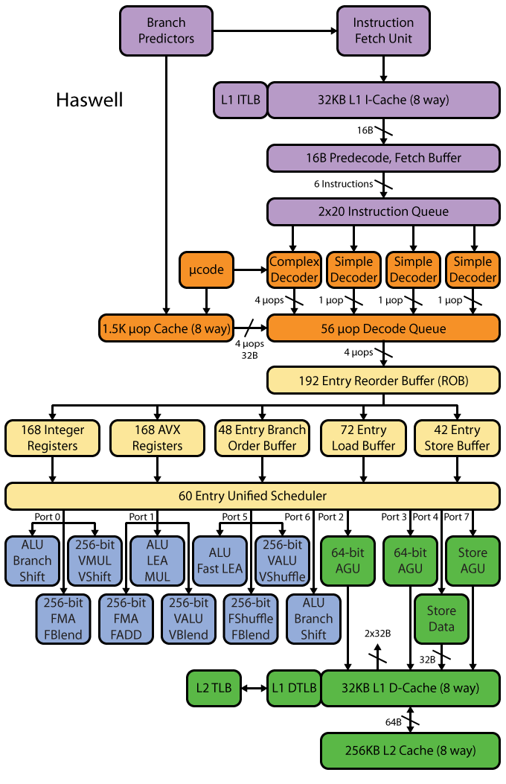
Intel Haswell example: ILP elicits very complex microarchitecture
[http://www.realworldtech.com/haswell-cpu/ ]→
Notes:
Dan - AGU: Address generation unit

Slide 89
Sample Pipeline Depths
Pipeline Depth | Processors
6 | UltraSPARC T1
7 | PowerPC G4e
8 | UltraSPARC T2/T3, Cortex-A9
10 | Athlon, Scorpion
11 | Krait
12 | Pentium Pro/II/III, Athlon 64/Phenom, Apple A6
13 | Denver
14 | UltraSPARC III/IV, Core 2, Apple A7/A8
14/19 | Core i*2/i*3 Sandy/Ivy Bridge, Core i*4/i*5 Haswell/Broadwell
15 | Cortex-A15/A57
16 | PowerPC G5, Core i*1 Nehalem
18 | Bulldozer/Piledriver, Steamroller
20 | Pentium 4
31 | Pentium 4E Prescott
[http://www.lighterra.com/papers/modernmicroprocessors/]→

Slide 90
The ILP Wall
Dedicated hardware speculatively executes future instructions before the results of current instructions are known, while providing hardware safeguards to prevent the errors that might be caused by out of order execution
Branches must be “guessed” to decide what instructions to execute simultaneously
If you guessed wrong, you throw away that part of the result
Data dependencies may prevent successive instructions from executing in parallel, even if there are no branches
Predicting the future comes at the cost of microarchitecture complexity and power cost

Slide 91
The ugly head of speculative execution
Speculative execution difficult to implement safely
Has become infamous for a recently-revealed series of vulnerabilities
Foreshadow (Intel, 2018)
Meltdown (Intel, Apple)
Spectre (Intel, Apple, ARM, AMD)
Everything before 2019 that uses branch prediction
Arbitrary locations in the allocated memory of a program can be read

Slide 92
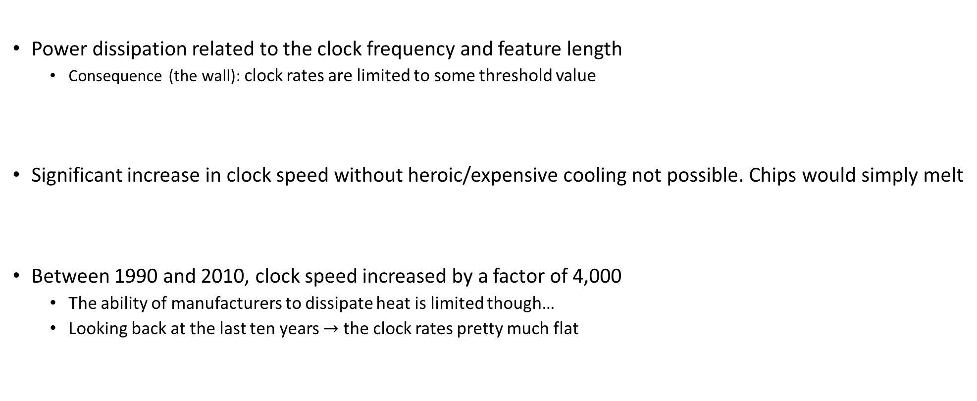
_{[The last wall]} The Power Wall
Power dissipation related to the clock frequency and feature length
Consequence (the wall): clock rates are limited to some threshold value
Significant increase in clock speed without heroic/expensive cooling not possible. Chips would simply melt
Between 1990 and 2010, clock speed increased by a factor of 4,000
The ability of manufacturers to dissipate heat is limited though…
Looking back at the last ten years $→$ the clock rates pretty much flat

Slide 93
The Power Wall
Power, and not manufacturing, limits traditional general purpose microarchitecture improvements
Point made already in 1999 by F. Pollack, Intel Fellow, see here .
Kind of true, but sadly Intel not pushing the manufacturing frontier anymore. Taiwan & S. Korea do.
Leakage power dissipation gets worse as gates get smaller, because gate dielectric thicknesses decrease proportionately

Slide 94
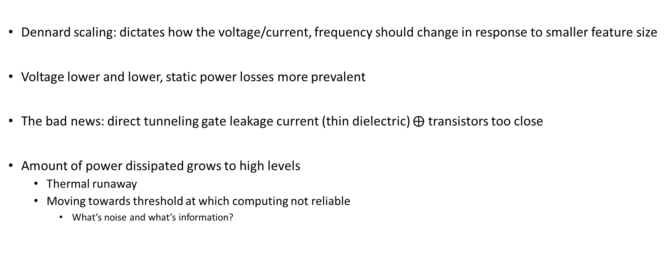
Dennard’s Scaling: Making Moore’s Law Useful
Dennard scaling: dictates how the voltage/current, frequency should change in response to smaller feature size
Voltage lower and lower, static power losses more prevalent
The bad news: direct tunneling gate leakage current (thin dielectric) $⨁$ transistors too close
Amount of power dissipated grows to high levels
Thermal runaway
Moving towards threshold at which computing not reliable
What’s noise and what’s information?

Slide 95
The “dark silicon”
Dark Silicon: transistors that manufacturers cannot afford to turn on
Too many transistors on a chip – cannot afford to power them lest the chip melts
Esmaeilzadeh, H.; Blem, E.; St.Amant, R.; Sankaralingam, K.; Burger, D., "Dark silicon and the end of multicore scaling," in Comp. Architecture (ISCA), 2011 38th Annual International Symp., pp.365-376, 2011

Slide 96
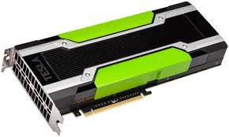
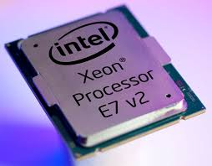
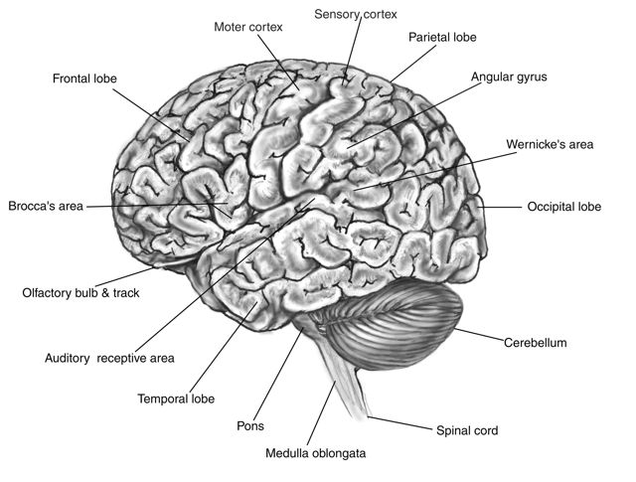
One slide detour: “spending energy” rates
NVIDIA Tesla K80
TDP: 300 Watts
Intel® Xeon® Processor E7-8890 v3
TDP: 165 Watts
Human Brain
20 Watts
Represents 2% of our mass
Burns 20% of all energy in the body at rest
Our entire body, ball park: 100-120 Watts
Notes:
[DN]
For a Opteron 6276, TDP is 115 W.
The Thermal Design Power (TDP) is the average maximum power a processor can dissipate while running commercially available software. TDP is primarily used as a guideline for manufacturers of thermal solutions (heatsinks/fans, etc) which tells them how much heat their solution should dissipate. TDP is not the maximum power the CPU may generate - there may be periods of time when the CPU dissipates more power than designed, in which case either the CPU temperature will rise closer to the maximum, or special CPU circuitry will activate and add idle cycles or reduce CPU frequency with the intent of reducing the amount of generated power.
TDP is usually 20% - 30% lower than the CPU maximum power dissipation.

Slide 97
Shift in Perception
Yesterday’s school of thought
Today’s take
Increasing clock frequency is primary method of performance improvement
Processors parallelism is primary method of performance improvement
Yesterday’s school of thought
Today’s take
Less than linear scaling for a multiprocessor is failure
Even sub-linear speedups are beneficial as long as you beat the sequential on a watt-to-watt basis

Slide 98
Conventional Wisdom in Computer Architecture
Power Wall
Old: Transistors expensive; Power is free
New: Transistors free; Power management very tricky (consequences, “lots of power”: heat to be dissipated & battery management)
Old: Math is slow; Memory access is fast
New: Math is fast; Memory slow (120 cycles for DRAM memory access, 1 cycle for pipelined FMA)
Old: Increasing Instruction Level Parallelism hardware and compilers (Out-of-order, speculation, VLIW, …)
New: ILP sees diminishing returns; non-ILP parallelism pursued
Memory Wall
ILP Wall
Notes:
Power wall + Memory wall + ILP wall → BRICK wall

Slide 99
Just a bunch of bad news…
OK, now what?

Slide 100
Another quote of the day
“The report of my death was an exaggeration.”
-- Mark Twain, American writer, humorist, entrepreneur, publisher, and lecturer [1835-1910]

Slide 101
The bright spot
We can produce small[er] transistors and we are increasingly good at packaging them in ICs

Slide 102
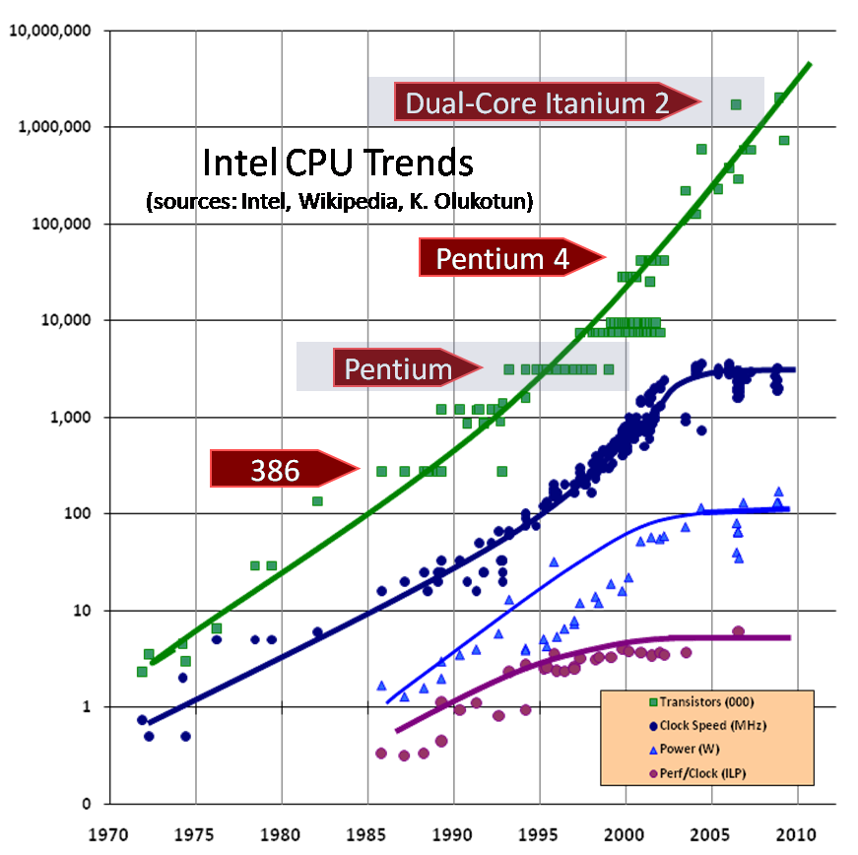
Good news: number of transistors going up

Slide 103
Moore’s Law (1965)
“The complexity for minimum component costs has increased at a rate of roughly a factor of two per year [see graph on next page]. Certainly over the short term this rate can be expected to continue, if not to increase. Over the longer term, the rate of increase is a bit more uncertain, although there is no reason to believe it will not remain nearly constant for at least 10 years. That means by 1975, the number of components per integrated circuit for minimum cost will be 65,000. I believe that such a large circuit can be built on a single wafer.”
“Cramming more components onto integrated circuits” by Gordon E. Moore, Electronics, Volume 38, Number 8, April 19, 1965

Slide 104
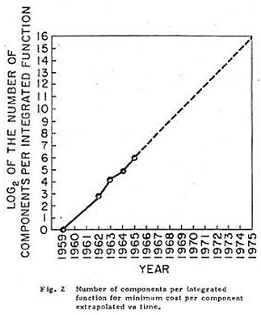
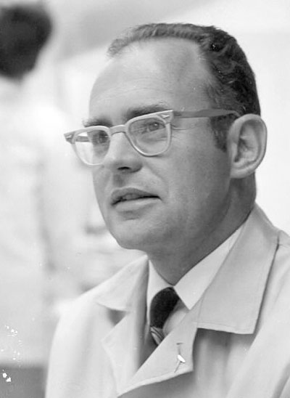

Moore’s Law
1965 paper: Doubling of the number of transistors on integrated circuits every two years
Moore himself wrote only about the density of components (or transistors) at minimum cost
http://news.cnet.com/Images-Moores-Law-turns-40/2009-1041_3-5649019.html

Slide 105


Slide 106
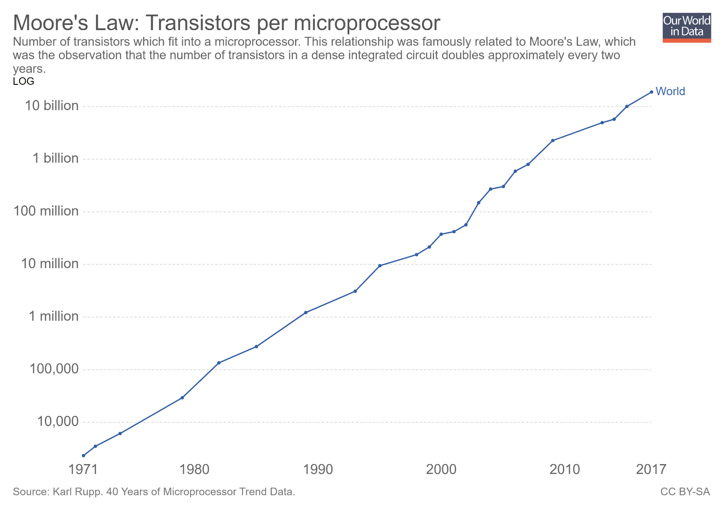
Moving to the processor: transistor counts per microprocessor

Slide 107
Intel Roadmap [or other folks’ roadmap]
2013 – 22 nm Tick: Ivy Bridge – Tock: Haswell
2015 – 14 nm Tick: Broadwell – Tock: Skylake
2016 – 14nm “Refresh” Kaby Lake
2017 – 10 nm Cannon Lake (delayed to 2019)
2019 – 7 nm [AMD: Radeon Instinct MI60/Zen2]
2021 – 5 nm (Samsung & TSMC, in testing)
2023 – 3 nm (Samsung?)
Notes:
Hammad: Even intel is having problems going down in process technologies. 10nm was delayed until the second half of 2017. Broadwell didn’t have good yields, they never released a desktop version (only laptop) and went straight to skylake for desktop CPUs

Slide 108

[OurWorldInData.org]$→$

